Slide 1





FINANCIAL LITERACY
JUMPSTARTING PERSONAL FINANCE CONCEPTS AND GOALS, NFA STYLE.
*For Educational Use Only.

Slide 2


LESSON OUTLINE
Introduction
01
Four Cornerstones
02
Buckets of Money
03
Time Value of Money
04
Money Management
05
Benefits
06
Financial Tips
07

Slide 3


INTRODUCTION
WHAT IS FINANCIAL LITERACY?
Financial literacy is the knowledge and understanding of various financial concepts, tools, and practices needed to navigate the financial world and make informed financial choices.
Understanding personal finance helps individuals build a positive relationship with money so they can spend and save responsibly.

Slide 4
Four Cornerstones
Short Term
Long Term / Asset Accumulation
Liquidity
Retirement Accounts - Tax Advantages
Risk Management
Investments
Insurance
Retirement

Slide 5
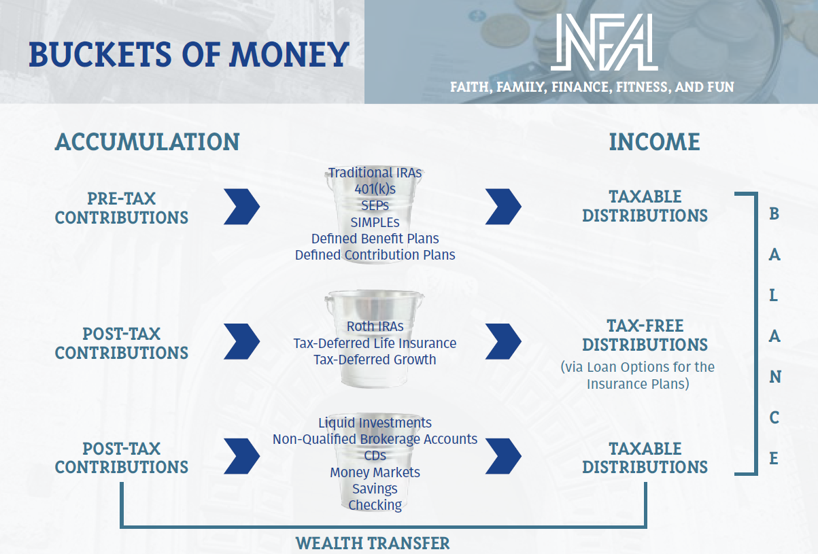

Slide 6

Future Value Calculation: Cost of Waiting
Current Age | Monthly Contribution | Assumed Rate of Return | Approximate Value at Age 65
25 | $50 | 6.5% | $114,180
30 | $50 | 6.5% | $80,015
35 | $50 | 6.5% | $55,308
40 | $50 | 6.5% | $37,441
45 | $50 | 6.5% | $24,521

Slide 7
Budgeting
01
02
Saving
MONEY MANAGEMENT
03
Investing
To better understand financial literacy, we can look at five key concepts.
04
Borrowing
05
Planning for the Future

Slide 8

MONEY MANAGEMENT
Budgeting involves having a spending plan based on your income and expenses. To create a budget, you need to consider the following:
01
BUDGETING
  Income - any money you receive
  Fixed expenses - expenses that usually cost the same each month and are paid on a regular basis
  Discretionary spending - money spent on nonessentials
  Savings - money put aside each month for emergencies or later use
50/20/30 RULE:
A simple budgeting formula where 50% of your income goes towards things you need, 20% goes towards savings, and 30% goes towards things you want.

Slide 9
FIXED OR VARIABLE?
Look at the following expenses and decide which are fixed (stay constant each month) and which are variable (differ each month). Which do you consider essential?
Streaming services
Phone bill
Medical expenses
Groceries
Gym membership
Rent
Fast food
Internet bill
Car repairs

Slide 10
MONEY MANAGEMENT
Saving money helps you cover future expenses, such as higher priced items, and emergencies. You will most likely encounter unplanned expenses or even periods between jobs.
Having money saved can help you cover those costs, give you financial stability, and give you more flexibility to explore other opportunities.
02
SAVING
SAVINGS TIP:
Automate your savings to ensure money is set aside each month.

Slide 11

MONEY MANAGEMENT
Investing involves growing your money over time by allocating money to stocks, bonds, real estate, and more. Although it involves higher risk than savings, it can also yield higher returns.
Investing gives you a sound foundation for your future and allows you to practice self-discipline and time management skills.
Investing in involves risk, including possible loss of principal.
03
INVESTING
LPL
Financial
FIND AN APP:
Investing has never been easier due to digital technology. Many reputable financial institutions have apps that make it simple to start investing today.

Slide 12
MONEY MANAGEMENT
There may come a time when you need more money than what you currently have—such as when you’re ready to buy a home. In that case, you may need a mortgage. Mortgages can be helpful as long as you understand the terms of your loan and borrow responsibly.
It's important to plan ahead so you're aware of the different mortgage options available, repayment obligations, and interest rates.
Good Debt vs. Bad Debt
04
BORROWING
CREDIT:
With credit cards, it is best to only spend what you can make timely payments on. Missing a payment can hurt your credit score, which is used by companies to decide if they will offer you a loan.

Slide 13
MONEY MANAGEMENT
Retirement might seem far away, but it is best to be proactive when it comes to planning for the future. The earlier you start, the more stable your financial future can be.
One benefit is that thinking ahead allows you to figure out how much you need to save and invest each year to reach your financial goals.
05
PLANNING FOR THE FUTURE
RETIREMENT PLANS

Slide 14

Take a moment to define your personal vision of financial success—what does true financial freedom look like for you?
DEFINE YOUR
VISION
Identify goals and priorities
Focus on feelings, not just numbers
Education is key
YOUR VISION OF FINANCIAL SUCCESS

Slide 15
SETTING FINANCIAL GOALS
Goals create accountability and motivation. Once you assess your current financial situation, you can write a SMART goal to achieve your ambitions.
S
M
A
R
T
SPECIFIC
MEASURABLE
ATTAINABLE
RELEVANT
TIMELY
What exactly are you trying to achieve?
How will you know when you’ve achieved your goal?
Is this goal realistically achievable?
How is this goal helpful
to you?
When will you achieve
this goal?

Slide 16
BENEFITS ^{OF} FINANCIAL LITERACY
Financial Empowerment
Financial knowledge and tools allow you to be in charge of your financial situation and make informed decisions. These skills help create disciplined spending habits.
01
Security
Responsible budgeting and saving can give you the confidence to face unexpected financial expenses.
02
Goal Achievement
Short-term and long-term goals are great ways to take steps towards achieving your financial ambitions.
03
Stress
Reduction
Money can be a cause of anxiety and stress. Having financial skills helps ease that stress and gives you confidence in your decisions.
04
Wealth Accumulation
Saving and investing allows you to have a more financially confident future and can lead to early retirement.
05

Slide 17

FINANCIAL TIPS
At least once a year, reevaluate your financial plan. Perhaps you are earning more income, or your budget is too restrictive. It is okay to make changes that fit your personal financial goals.
01
02
Small changes can make a big difference over time. For example, put a little bit more income into savings each month or decrease how often you go out to eat.
Create a positive financial mindset. Thinking about finances doesn’t need to be overwhelming. Be aware of your spending habits. Take note of your strengths and areas where you can improve.
03

Slide 18


CONTACT US
NATIONAL FINANCIAL ALLIANCE
PH. 210-737-7800
NFAEMPOWERS@TNFA.NET
901 NE LOOP 410, STE. 100
SAN ANTONIO, TEXAS 78209
WWW.TNFA.NET
Securities offered through LPL Financial, Member FINRA/SIPC. Investment advice offered through Strategic Financial Concepts, LLC, a registered investment advisor. Strategic Financial Concepts LLC, NFA Wealth Management, National Financial Alliance, NFA Institutional Services, and NFA Insurance are separate entities from LPL Financial.

