Slide 1



WWW.TNFA.NET
UNDERSTANDING INVESTMENTS
Securities offered through LPL Financial, Member FINRA/SIPC. Investment advice offered through Strategic Financial Concepts, LLC, a registered investment advisor. Strategic Financial Concepts LLC and National Financial Alliance are separate entities from LPL Financial
Notes:
Hello Everyone,
I am Reagan Wagner – CEO of National Financial Alliance. Today is about building clarity and confidence around investing. This is not about picking the perfect investment or timing the market. It’s about understanding the basics so you can make more informed decisions and feel more comfortable having these conversations.

Slide 2

INTRODUCTION TO INVESTING
What is an investment?
Placing money into something today to earn more in the future.
Why people invest:
Grow wealth
Earn income
Meet goals like retirement, education, or home ownership
When you hear the word investing, what’s your first thought? Excitement, confusion, or fear?
WWW.TNFA.NET
Notes:
When we talk about investing, at its core it simply means putting money to work today with the goal of benefiting in the future. People invest for different reasons. Some want growth, some want income, and others want to reach specific life goals like retirement or education.
Before we go any further, I’d love to pause here and ask. When you hear the word investing, what comes to mind first? Excitement, confusion, or maybe even fear? All of those are completely normal reactions.

Slide 3




COMMON TYPES OF INVESTMENTS
Low-Risk Savings: Checking accounts, CDs, money markets
Stocks: Ownership in companies
Bonds: Lending money to companies or governments
Mutual Funds: Pooling money with others to invest together
Real Estate: Property for income or growth
Business Ownership: Direct control over an enterprise
WWW.TNFA.NET
Notes:
There are many different ways to invest, and they all serve different purposes. Low-risk savings are about accessibility and stability. Stocks represent ownership in companies. Bonds are essentially loans you make to governments or corporations. Mutual funds allow investors to pool money together for diversification. Real estate and business ownership tend to be more hands-on approaches. The key takeaway here is that no single investment fits every goal or every person.

Slide 4



THE RISK–REWARD RELATIONSHIP
Generally: Higher potential returns = higher risks
Types of Investment Risks:
Inflation risk
Market risk
Credit/default risk
Liquidity risk
Timing risk
Knowing your risk tolerance is key to choosing investments.
QR code to link the risk tolerance quiz: https://tnfa.net/quiz
WWW.TNFA.NET
Notes:
A fundamental concept in investing is the relationship between risk and reward. Generally speaking, the more return you hope for, the more risk you may need to accept. Risk comes in many forms, not just market ups and downs. Inflation, liquidity, timing, and credit risk all play a role. That’s why understanding your personal risk tolerance is so important. We’ve included a QR code here for a quick risk tolerance quiz. This can be a helpful starting point for understanding how comfortable you are with different levels of risk.

Slide 5

SETTING INVESTMENT GOALS
Emergency fund (4–6 months of expenses)
Retirement income
College savings
Estate creation or charitable giving
Asset purchases (home, vehicle, etc.)
Of the above goal topics what feels most urgent to you right now?
WWW.TNFA.NET
Notes:
Investing works best when it’s tied to clear goals. Some goals are short-term, like building an emergency fund. Others are long-term, like retirement or estate planning.
Your goals help determine how much risk you may be willing to take and how your portfolio should be structured.
Let me ask: Of the goals listed here, which one feels most urgent or important to you right now?

Slide 6
UNDERSTANDING EXCHANGE-TRADED FUNDS (ETFS)
ETFs are collections of investments (like stocks or bonds) that trade on an exchange, similar to individual stocks.
Have you ever heard of ETFs before?
What do you think makes them different from mutual funds?
Key Features:
Typically track an index (like the S&P 500)
Prices change throughout the trading day
Lower costs and higher liquidity than many mutual funds
Advantages: Diversification, flexibility, and cost efficiency
Consider: Trading fees and market fluctuations
WWW.TNFA.NET
Notes:
ETFs are investment collections that trade throughout the day like individual stocks. Many ETFs are designed to track an index, which helps keep costs lower and provides broad diversification. They’re popular because they offer flexibility, transparency, and efficiency. Like all investments, they still experience market ups and downs, so it’s important to understand how they fit into your overall strategy.
Quick question. Have you heard of ETFs before, and what do you think sets them apart from mutual funds?

Slide 7

Why Investors Use Bonds:
Provide steady income
Help balance portfolio risk
Preserve capital
Types of Bonds:
Government Bonds – low risk, steady return
Corporate Bonds – higher yield, higher risk
Municipal Bonds – may offer tax advantages
Risk Factors: Interest rate changes, credit risk, and inflation
BONDS:
THE POWER OF FIXED INCOME
Bonds are loans you make to corporations or governments in exchange for interest payments.
When thinking about bonds, what feels more appealing — steady income or low risk?
WWW.TNFA.NET
Notes:
Bonds are essentially loans you make to governments or companies in exchange for interest payments. Investors often use bonds to provide income and help reduce overall portfolio volatility.
Different types of bonds carry different levels of risk and return. While bonds are generally considered more stable than stocks, they are still affected by interest rates, inflation, and credit quality.
When you think about bonds, what feels more appealing to you. Steady income or lower risk?

Slide 8



MUTUAL FUNDS
MADE SIMPLE
Professionally managed investment pools
Offer diversification and convenience
Types of funds:
  Income funds (bonds, dividends)
  Growth funds (stocks, appreciation)
  Balanced funds (mix of both)
Available as open-end or closed-end funds
WWW.TNFA.NET
Notes:
Mutual funds pool money from many investors and are professionally managed. This allows individuals to gain diversification and professional oversight without selecting individual securities themselves. Funds are typically designed around specific goals like income, growth, or a balance of both. They can be structured as open-end or closed-end funds, each with different features.

Slide 9
HOW MUTUAL FUNDS WORK
Investors buy shares
Fund managers invest in a portfolio
Income and gains are passed to shareholders
Investors can buy or sell at the fund’s Net Asset Value (NAV)
WWW.TNFA.NET
Notes:
When you invest in a mutual fund, you buy shares of the fund. The fund manager makes investment decisions on behalf of all shareholders.Income and gains are passed through to investors, and shares are bought or sold at the fund’s Net Asset Value, or NAV. This structure makes mutual funds accessible and easy to manage for many investors.

Slide 10
VARIABLE ANNUITIES –
A HYBRID OPTION
Offered by insurance companies
Combines investing with insurance features
Earnings grow tax-deferred
Includes options for guaranteed income or market-linked returns
Requires insurance and FINRA licenses to sell
WWW.TNFA.NET
Notes:
Variable annuities combine investment features with insurance elements. They allow for tax-deferred growth and may offer optional guarantees, depending on the contract. Because they are both insurance products and securities, they require additional licensing and oversight. These products can be useful in certain situations but are not appropriate for everyone.

Slide 11

EDUCATING YOURSELF
Use trusted sources:
The Wall Street Journal
Morningstar
Forbes
SEC resources
Understand fees, taxes, and long-term effects before investing
WWW.TNFA.NET
Notes:
The investment world is constantly changing, which makes education critical. Reliable sources like financial publications and independent research tools can help investors stay informed.
Understanding fees, taxes, and long-term implications can make a meaningful difference over time.

Slide 12


KEY TAKEAWAYS
Investing aims to grow wealth over time
Match your goals and risk tolerance
Diversify to manage risk
Educate yourself before making decisions
Seek professional advice when needed
What’s one small step you’ll take this week to move closer to your investment goals?
WWW.TNFA.NET
Notes:
To wrap up, investing is about progress, not perfection. Matching your investments to your goals and risk tolerance is key. Diversification helps manage risk, and ongoing education empowers better decisions.
Before we end, I’ll leave you with one final question. What is one small step you can take this week to move closer to your investment goals?

Slide 13
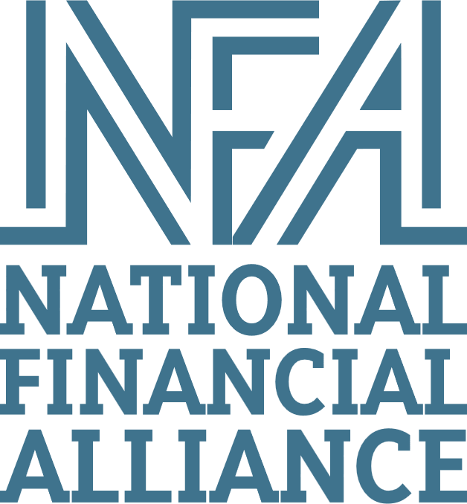
Helping you pursue your Vision of Financial Success.
https://tnfa.net/quiz
Contact us at nfaempowers@tnfa.net
WWW.TNFA.NET

Slide 14
DISCLOSURES
The opinions voiced in this material are for general information only and are not intended to provide specific advice or recommendations for any individual. All performance referenced is historical and is no guarantee of future results. All indices are unmanaged and may not be invested into directly.
ETFs trade like stocks, are subject to investment risk, fluctuate in market value, and may trade at prices above or below the ETF's net asset value (NAV). Upon redemption, the value of fund shares may be worth more or less than their original cost. ETFs carry additional risks such as not being diversified, possible trading halts, and index tracking errors.​
Government bonds and Treasury bills are guaranteed by the US government as to the timely payment of principal and interest and, if held to maturity, offer a fixed rate of return and fixed principal value.
The market value of corporate bonds will fluctuate, and if the bond is sold prior to maturity, the investor’s yield may differ from the advertised yield.
Municipal bonds are subject to availability and change in price. They are subject to market and interest rate risk if sold prior to maturity. Bond values will decline as interest rates rise. Interest income may be subject to the alternative minimum tax. Municipal bonds are federally tax-free but other state and local taxes may apply. If sold prior to maturity, capital gains tax could apply.
Fixed and Variable annuities are suitable for long-term investing, such as retirement investing. Gains from tax-deferred investments are taxable as ordinary income upon withdrawal. Guarantees are based on the claims paying ability of the issuing company. Withdrawals made prior to age 59 ½ are subject to a 10% IRS penalty tax and surrender charges may apply. Variable annuities are subject to market risk and may lose value.​
WWW.TNFA.NET

